Slide 1
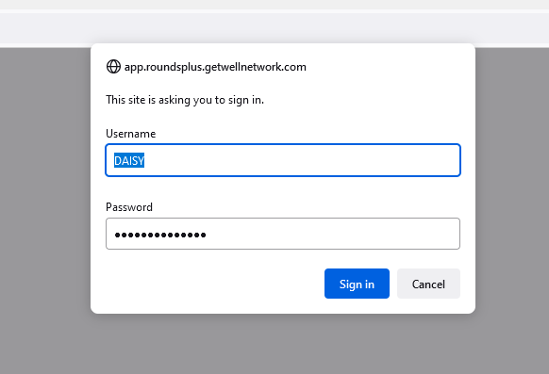
Nomination Report FAQ’s and Tips
We will send you a custom link to your report. You cannot log in directly to getwell or Rounds+ to access the report. You must use the link provided. If you need your link again, don’t hesitate to reach out.
When you click on the link provided, you should get a prompt to enter your username and password. If you do not receive this prompt, please troubleshoot with the following:
Retype your password being sure that spelling is correct and there is not an extra space at the end
Try a different browser
Clear your browser cache and cookies.
In your browser settings, remove the saved password for this page
Allow pop-ups
Please contact your IT department if none of the above solutions work for you

Slide 2
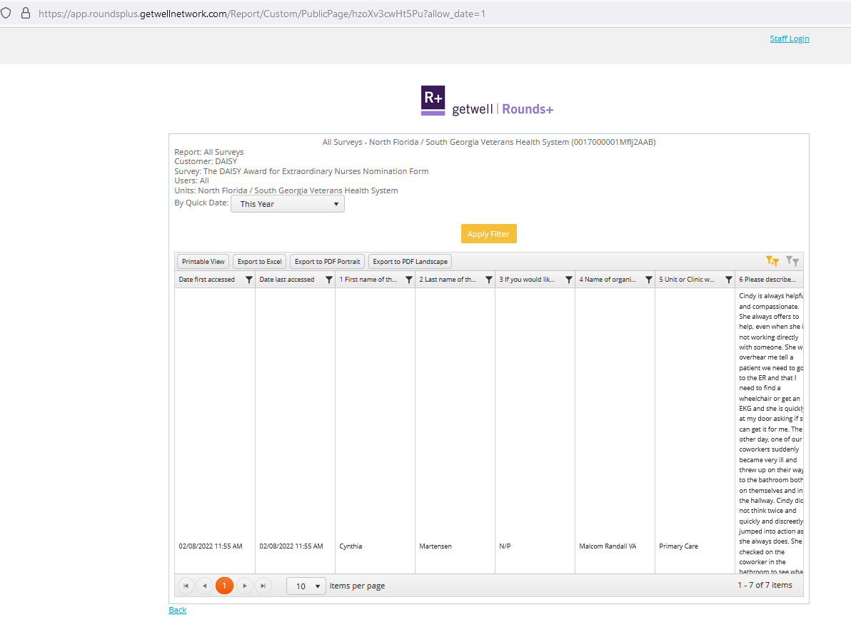
Once you have accessed the report, you can change the date to sort your nominations.
Be sure to click “apply filter” to make the change
If you do not see the option to change the date, make sure your URL ends in ?allow_date=1
The easiest way to view your nominations is to export them to excel.
If you do not see the document after you click export to Excel, check your downloads folder
Once you open the report, it will look like this:

Slide 3
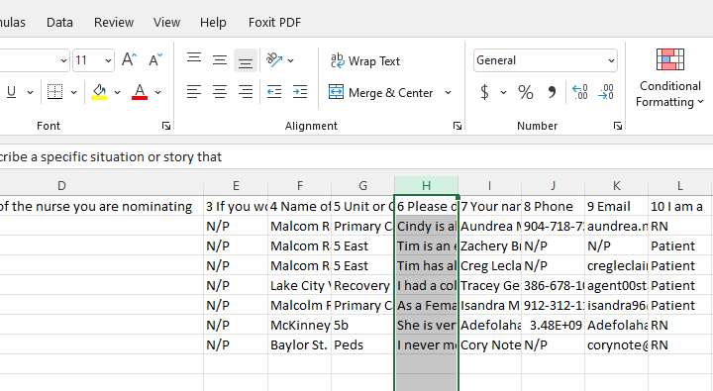
Tips for making your report easy to read:
You can delete any columns you don’t want to use/see. Simply click on the letter of the column at the top that you want to delete, right click your mouse, and select delete.
You can expand a column by double clicking the line between it and the next column. Note: your cursor will change to two arrows with a line in the middle when you are over the correct spot to expand.
You can make the nomination story easier to read by selecting the column (by clicking on the letter above it) and then clicking “wrap text” towards the top of your screen.

Slide 4
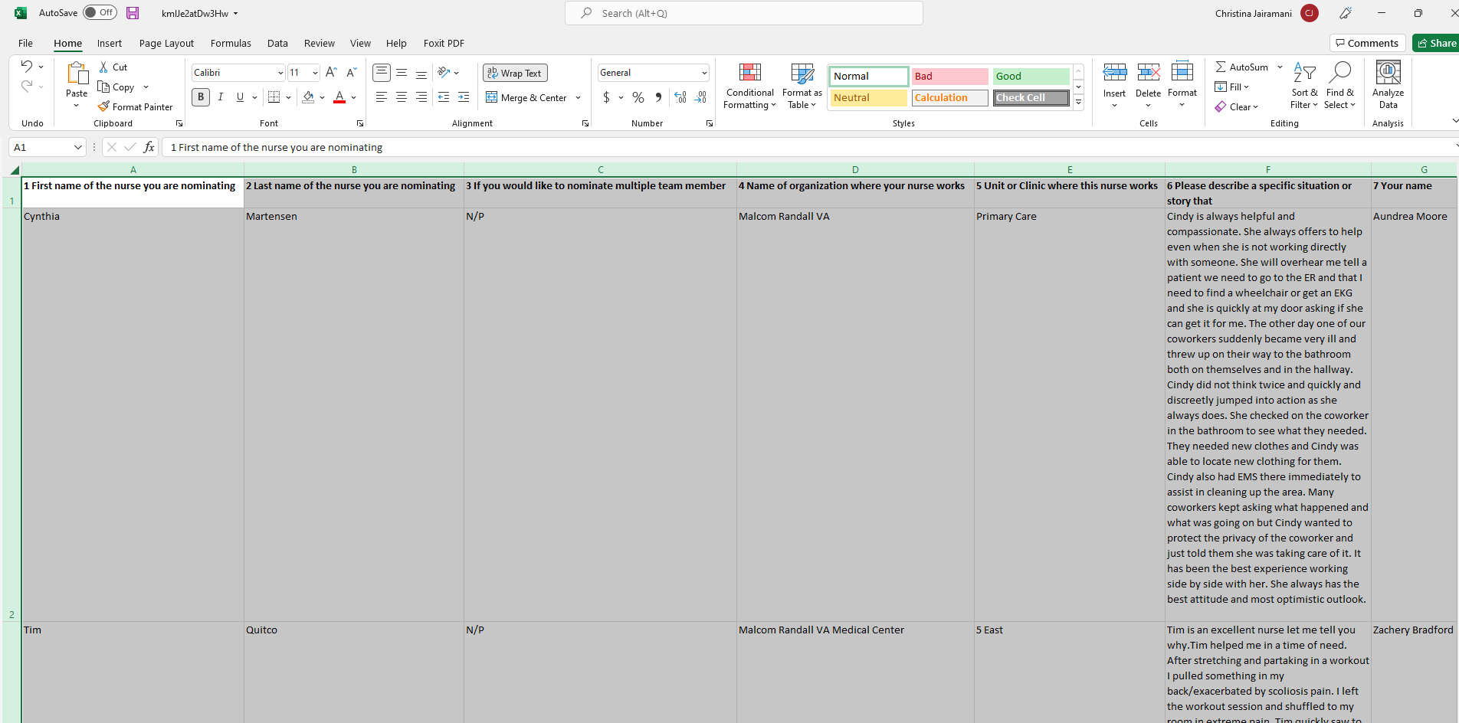
Tips for making your report easy to read:
Finally, you can shift the text to the top of each cell so it lines up nicely with your nomination story. Click the little triangle in the upper left corner of the spreadsheet to highlight everything. Then click the upper left lines in the alignment section of the toolbar/ ribbon.
Extra tip:
Using Excel makes it easy to blind your nominations! You can click on the cell with the nomination story then hold Ctrl down and hit your H key) to bring up the replace option. You can replace the nurses name with something else (Replace Cindy with X for example). Don’t forget to do plurals too!

