Slide 1
Neuroscience Update Lecture Series
Introduction to Brain Tumors

Slide 2
Objectives:
Provide an overview of Brain tumors
Review concepts of pathology and treatment
Review key nursing interventions
Notes:
New Slide

Slide 3
What Is the Incidence?
16,000 new cases each year
13,000 deaths attributed to brain tumor
2.4% of all cancer deaths
60% are malignant gliomas

Slide 4
Etiology
Primary - unknown
Genetic - hereditary
Metastatic
35% - lung
20% - breast
10 % - kidney
10% - gastrointestinal tract

Slide 5
Primary Brain Neoplasms: Frequency*
*Total is >100 due to rounding.
GBM = glioblastoma multiforme.
Levin VA, et al. In: Cancer Principles and Practice of Oncology. 1997;2022-2082.
Notes:
Read through slide
Reference:
1. Levin VA, et al. In: Cancer Principles and Practice of Oncology. 1997;2022-2082.

Slide 6
Glioma Grading
Grade | Tumor type | Glioma%
I/II | Well differentiated (low grade astrocytoma) | 15-20
III | Anaplastic astrocytoma | 30-35
IV | Glioblastoma Multiforme | 40-50

Slide 7
Why is Pathology So Important: Median survival
Tumor type | Median Survival
I/II Well differentiated (low grade astrocytoma) | 5-10 years
III Anaplastic astrocytoma | 3 years
IV Glioblastoma Multiforme | 12 -18 months

Slide 8
Who Gets Brain Tumors?
Astrocytoma- most common in young adults 30-50
GBM- more common in older adults 55-65
Astrocytoma, Brain stem glioma, PCA, PNETS

Slide 9
Key Clinical Questions
What is the patients’ overall clinical health?
Guides decision making for treatment choices
Is this a tumor only in the brain or do they have cancer somewhere else?
Are there any clues on the imaging studies of the brain that tell us what type of tumor it is?

Slide 10
Quality of Life
No universal definition for QOL
Many available HRQOL surveys
Most measure physical and cognitive symptoms
Progression free survival
Some allow surrogates and others require that the patient answer

Slide 11
MRI Brain
Some tumors such as meningioma, acoustic schwannoma, can be identified largely based on radiographic characteristics
Low grade astrocytoma usually non-enhancing, best seen on t2/flair
PITFALL- To be sure, tumors require biopsy for a pathological diagnosis

Slide 12
Diagnostic Procedures
Radiological Imaging
Computed Tomography Scan (CT Scan) with/without contrast
Magnetic Resonance Imaging (MRI) with/without contrast
Positron Emission Tomography scan (PET scan)
Notes:
Diagnostic Procedures
Computed Tomography (CT Scan)
evaluate bony lesions, hemorrhages with enhancement – enhancing tumors
may miss smaller parenchymal lesions
Magnetic Resonance Imaging (MRI)
structures shown in three planes
with and without contrast – enhancing lesions
document smaller parenchymal lesions
MRI angiography – visualization of vascular structures
MR Spectroscopy – documents chemical composition- brain metabolites – increased choline peak – tumor lactate peak – tumor necrosis diagnostic and prognostic tool
Positron Emission Tomography scan (PET scan)
F-18 fluorodeoxyglucose (FDG)
measures tissue metabolism
differentiate treatment related necrosis vs. tumor necrosis

Slide 13
Goals of Treatment
Cure? Complete resection +/- adjunctive treatment with radiation/chemotherapy
Prolong life
Control local infiltration of tumor cells
Palliation ( make things better briefly, control symptoms, not to cure)

Slide 14
Are There Really Benign Brain Tumors?
Better named, slow growing
All can behave in a malignant fashion
Overall survival from any brain tumor diagnosis at 5 years estimated 13-26%

Slide 15
Extra-axial
Meningioma
Metastatic
Acoustic Neuromas (Schwannoma)
Pituitary adenoma
Prolactin-secreting
Growth hormone – deficiency
Adulthood
Neurofibroma
Notes:
Extra-axial -originate from supporting structures of CNS
Meningioma - slow-growing, attached to meninges, usually benign
Metastatic
usually from lung, breast, kidney and GI
enhancing – necrotic – center, peri-tumoral edema, occurs in gray matter
Acoustic neuroma – VIII cranial nerve – benign
Pituitary adenoma
classification by hormone secretion
classification by location- adenohypophysis – anterior pituitary
prolactin-secreting – serum prolactin - >500mU/L
a. micro-adenoma – hyperprolatinemia, galactorrhea, amenorrhea, infertility, males – impotence
b. macro –adenoma – mild hyperprolactinemia due to disruption of pituitary stalk
growth hormone – deficiency
childhood – dwarfism, slow/absent growth
absent/delayed sexual development, cephalofacial disproportion
Adulthood-
increased body fat, decreased muscle mass
decreased bone density – increased risk of fractures, impaired glucose tolerance
Neurofibroma – genetic because of autosomal dominant mendelian trait, firm, encapsulated lesions
attach to nerve, benign, late in childhood/early adolescence, surgery, radiation

Slide 16
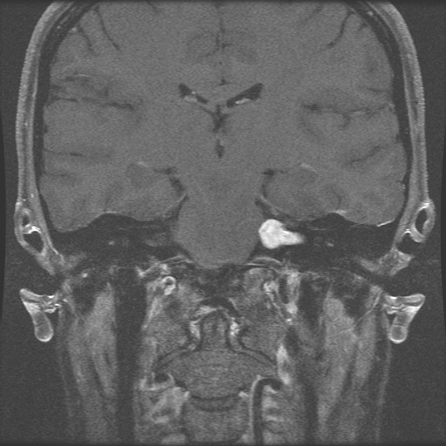
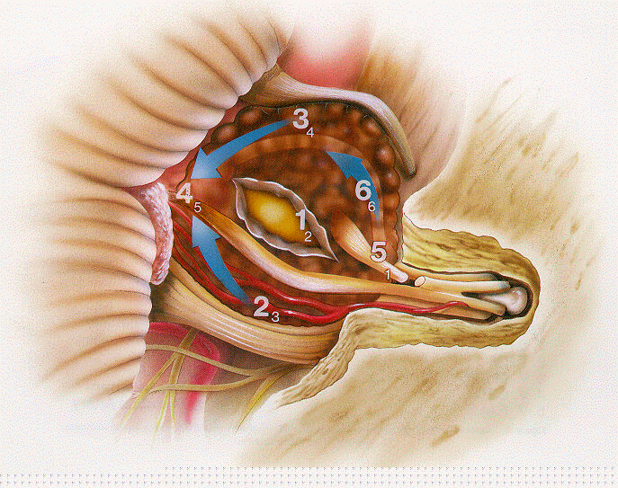
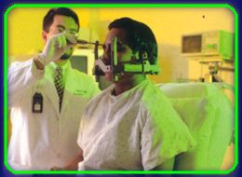
-Dumbbell shape
-Level of eighth cranial nerve
Acoustic schwannoma

Slide 17
Acoustic Schwannoma
Considered benign
Radiosurgery has largely replaced open surgery
Goal is tumor control
Common symptoms, hearing loss, tinnitus, vertigo, headache, gait and balance disturbance

Slide 18
Facial nerve palsy
Clinically A BIG DEAL!!
Interferes with effective swallowing, predisposes to aspiration
Exposure keratopathy
Loss of self- image
Depression
Risk is 4-15% after open surgery and 1-3% after Gamma Knife

Slide 19
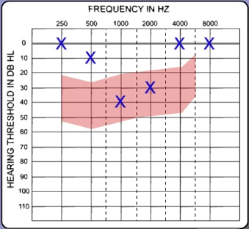
Hearing…What did you say?
Normal hearing and moderate hearing loss comparison

Slide 20
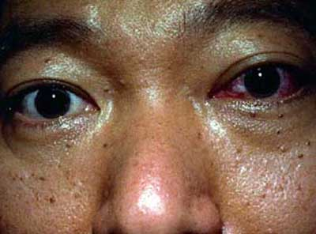
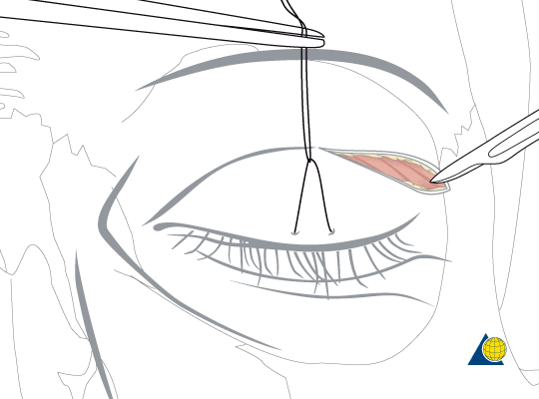
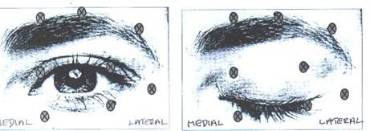
Exposure Keratopathy
Good nursing care is ESSENTIAL!!
Artificial tears Q2hr, Taped eye closure, early reporting of increased reddness- can cause blindness
For treatment failures
Bo Tox
Tarsohaphy

Slide 21
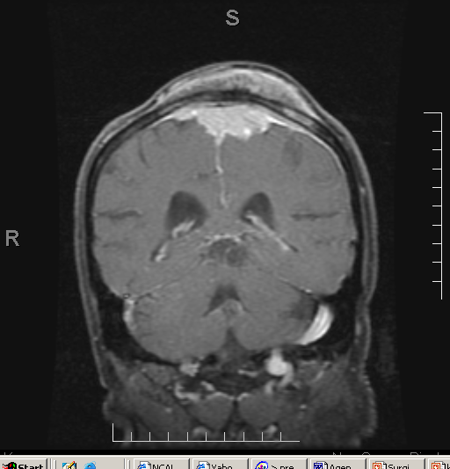
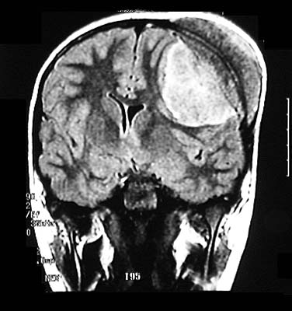
-Homogenously enhancing
Extra-dural
-Bony involvement
-Calcifications
Meningioma

Slide 22
Meningioma
Usually Benign, slow growing
May be observed, treated with open surgery or radiosurgery ( not primary treatment choice)
Often present with headache, seizure, sx based on location.
4-50% have recurrence ( Thought to be based on completeness of resection)

Slide 23
Meningioma
Radiographic signature features: homogenously enhancing extra-axial lesion
MRI not helpful in discriminating grade or histopathology
Intratumoral cystic change and extracranial tumor extension may help identify atypical/malignant meningiomas
Sources: Eur J Radiol. 2011 Jun 30. Is diffusion-weighted imaging useful in grading and differentiating histopathological subtypes of meningiomas?
J Clin Neurosci. 2010 May;17(5):584-7. Epub 2010 Mar 9.Do aggressive imaging features correlate with advanced histopathological grade in meningiomas?

Slide 24
Meningioma
Survival better in young people (81% in patients aged 21 to 64 and 56% for patients 65 years of age or older.)
5 year recurrence after any treatment 18.2-27.2%
Location an important variable in morbidity- proximity to venous sinuses, brain stem, sella, optic nerve
Meningioma carries the highest risk of DVT of all intracranial tumors (22-45%)
Sources: Central Brain Tumor Registry of the United States, Sawaya R, Cummins CJ, Kornblith PL: Brain tumors and plasmin inhibitors. Neurosurgery 15:795800, 1984, Sawaya RE, Ligon BL: Thromboembolic complications associated with brain tumors. J Neurooncol 22:173181, 1994, Sawaya R, Zuccarello M, Elkalliny M, et al: Postoperative venous thromboembolism and brain tumors: Part I. Clinical profile. J Neurooncol 14:119125, 1992

Slide 25
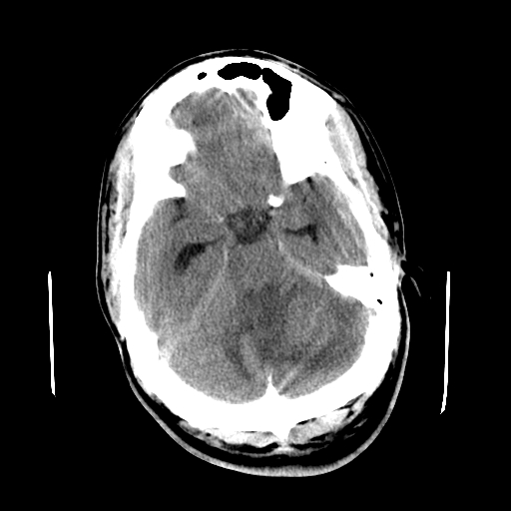
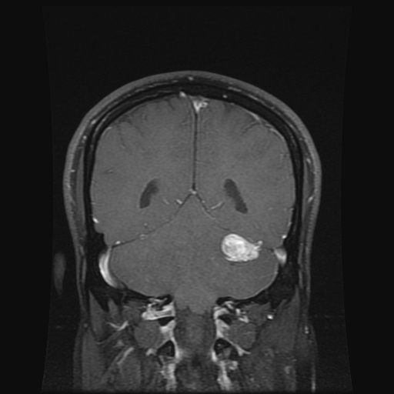
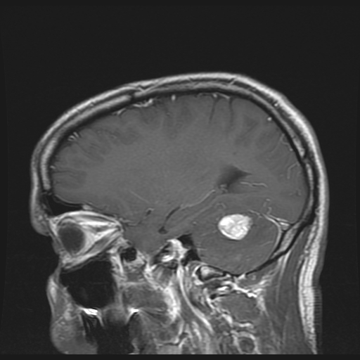
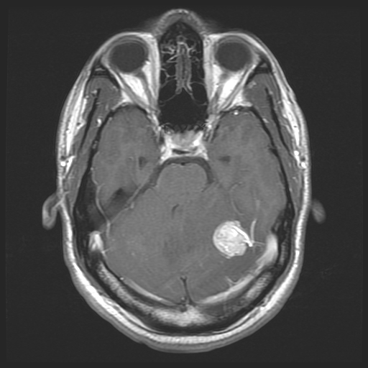

Slide 26
Hemangioparacytoma
Highly vascular tumor. Increased surgical blood loss

Slide 27
Glioblastoma Mutliforme
Malignant form primary brain tumor
Poor survival despite multimodal RX
Common tx resection +/- radiation, chemo
Rapid growth- may double every 10 days
Expected survival with tx 12-15 months from the time of diagnosis

Slide 28
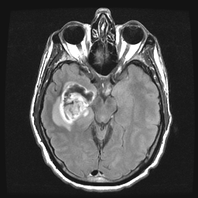
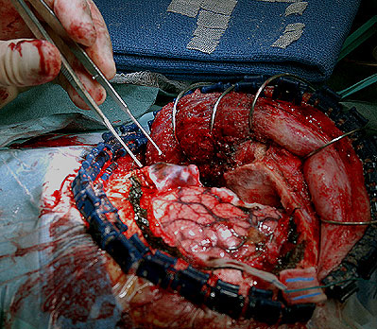
-Heterogeneous enhancement pattern
-Necrosis
-Cytotoxic edema (contains tumor)
-Crossing midline
Glioblastoma Multiforme

Slide 29
Surgery: General Outcomes in Malignant Glioma
Improved overall survival rates if GTR
Resected patients have improved QOL compared to biopsy alone
Improved results of subsequent radiation therapy and chemotherapy
Improved clinical outcomes
Levin VA, et al. In: Cancer Principles and Practice of Oncology. 1997;2022-2082.
Notes:
Read through slide
Reference:
1. Levin VA, et al. In: Cancer Principles and Practice of Oncology. 1997;2022-2082.

Slide 30
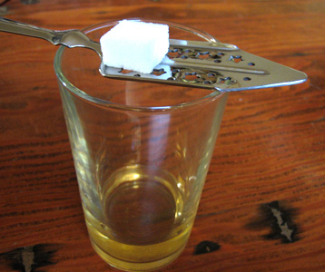
Limitations of Surgery
Eloquent brain (brain that is important for function)
Tumor multifocal, diffuse
Repeat craniotomy- increased risks of infection, CSF leak

Slide 31
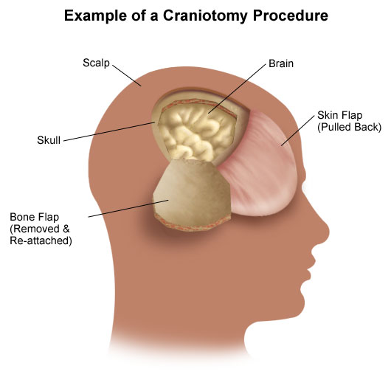
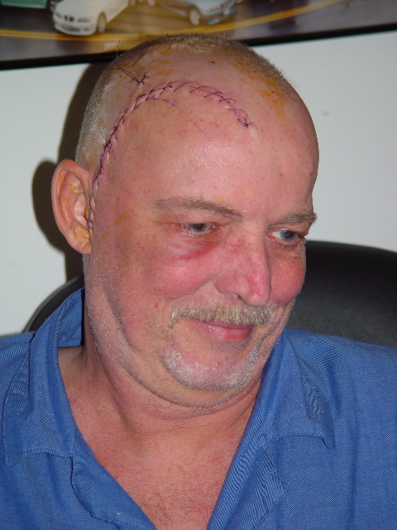
Standard Craniotomy
Notes:
31

Slide 32
New Surgical Options
Minimally invasive surgery
Uses natural corridors to access the brain
Less post operative pain, faster recovery
Reduces trauma to the brain and surrounding tissues

Slide 33
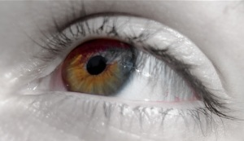
Surgery Through the Eyebrow
1 Inch incision through the eyebrow

Slide 34
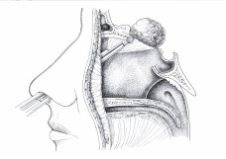
Endonasal Approach
Pituitary adenoma, meningioma, skull base lesions
Tumor removed without incisions

Slide 35
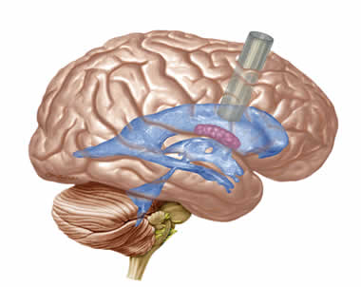
Brain Port
Ports are used to access important structures reducing trauma to important surrounding structures

Slide 36
Chemotherapy
Slows cell growth
Cytotoxic Drugs
CCNU, BCNU, PCV, Cisplatin, Etoposide, Vincristine, Temozolomide (Temodar)
Side effects
Oral mucositis, Bone marrow suppression, fatigue, hair loss, nausea/vomiting, anxiety, peripheral neuropathy
Notes:
Cancer cells are rapidly dividing cells
Combination of drugs sometimes used
Chemotherapeutic drugs are administered by the PO, IV or intrathecal routes
Acute side effects…
Oral mucositis….provide mouth care on regular bases
Check for bone marrow suppression…WBC with diff, Neurtrophils >1500
Fatigue…rest, check hemoglobin > 10, Platelets > 100,00
Hair loss..…encourage scarves and wearing makeup, review cause of hair loss and it will regrow
Nausea/vomiting…antiemetics
Anxiety…reassure positive attitude
Peripheral neuropathy…non-narcotics, opioid, adjuvant (antidepressants, anticonvulsants, anxiolytics)

Slide 37
GBM: Current Standard

Slide 38
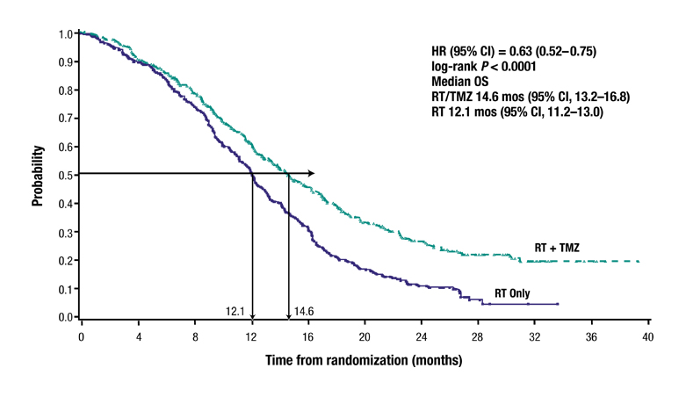
Overall Survival
HR (95% CI) = 0.63 (0.52–0.75) log-rank P<0.0001
14.6 VS 12.1
(n=287)
(n=286)

Slide 39
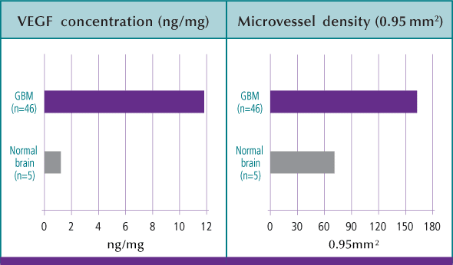
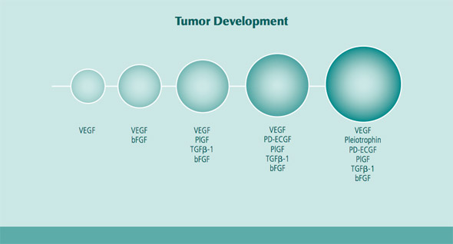
Starve the Tumor- Avastin

Slide 40
Limitation of Chemo
Anticonvulsants (Dilantin Carbamazapine, Phenobarbital) affect drug clearance
Corticosteroids have a cytoprotective effect
Survival effect modest in high grade GBM

Slide 41
Complications to be aware of
Steroid related- hyperglycemia, insomnia, behavioral changes, GI bleeding
Surgical site infection- high risk for wound break down with chemo/radiation
DVT- hypercoaguable state
UTI- prolonged catheter use
Chemo- oral mucositis, bone marrow supression
Radiation- FATIGUE!!!, hair loss

Slide 42
Depression
285 HGG patients were studied at 54 centers across the US and Canada
34% reported significant depression
Shortened survival time
Sadness IS common and expected
Key differences: present most of the day, interferes with daily life, causes or contributes to social isolation

Slide 43
Radiation Therapy
Damages DNA of rapidly dividing cells
4000 – 6000 Gy total dose
Duration of 4 – 8 weeks
Side Effects
Skin burns, hair loss, fatigue, local swelling
Patient teaching includes preparing the patient for side effects
Radiation necrosis
Notes:
Radiation is sensitive to cells that rapidly divide (ie brain tumor) – and normal tissue tooo
Low grade radiation
Daily radiation doses of 150-200Gy … goes +2cm margin beyond tumor bed
Types of Radiation
External beam radiation
Stereotactic radiosurgery (gamma, linac, cyberknife)
Interstitial brachytherapy – isotopes inserted into tumor bed, removed in 4-5 days
Skin burns are big concern….reddened skin from beam of radiation
Corticosteroids given during radiation to control cerebral edema
Radiation necrosis may occur after treatments are completed, may need to be surgically removed.

Slide 44
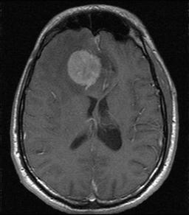
Case study
82 y/o male with right frontal meningioma

Slide 45
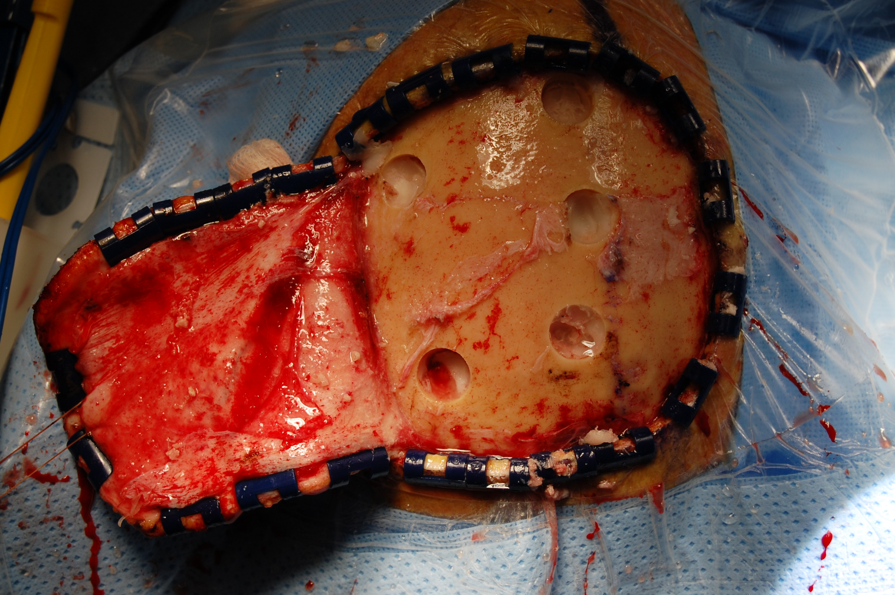
Operative Care

Slide 46
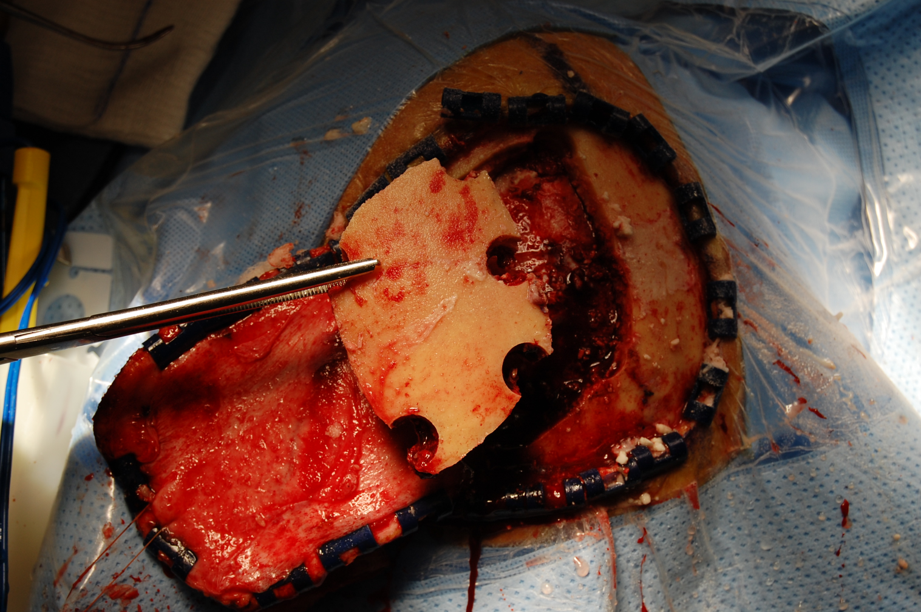
Operative Care

Slide 47
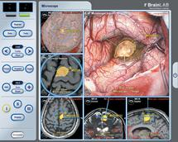
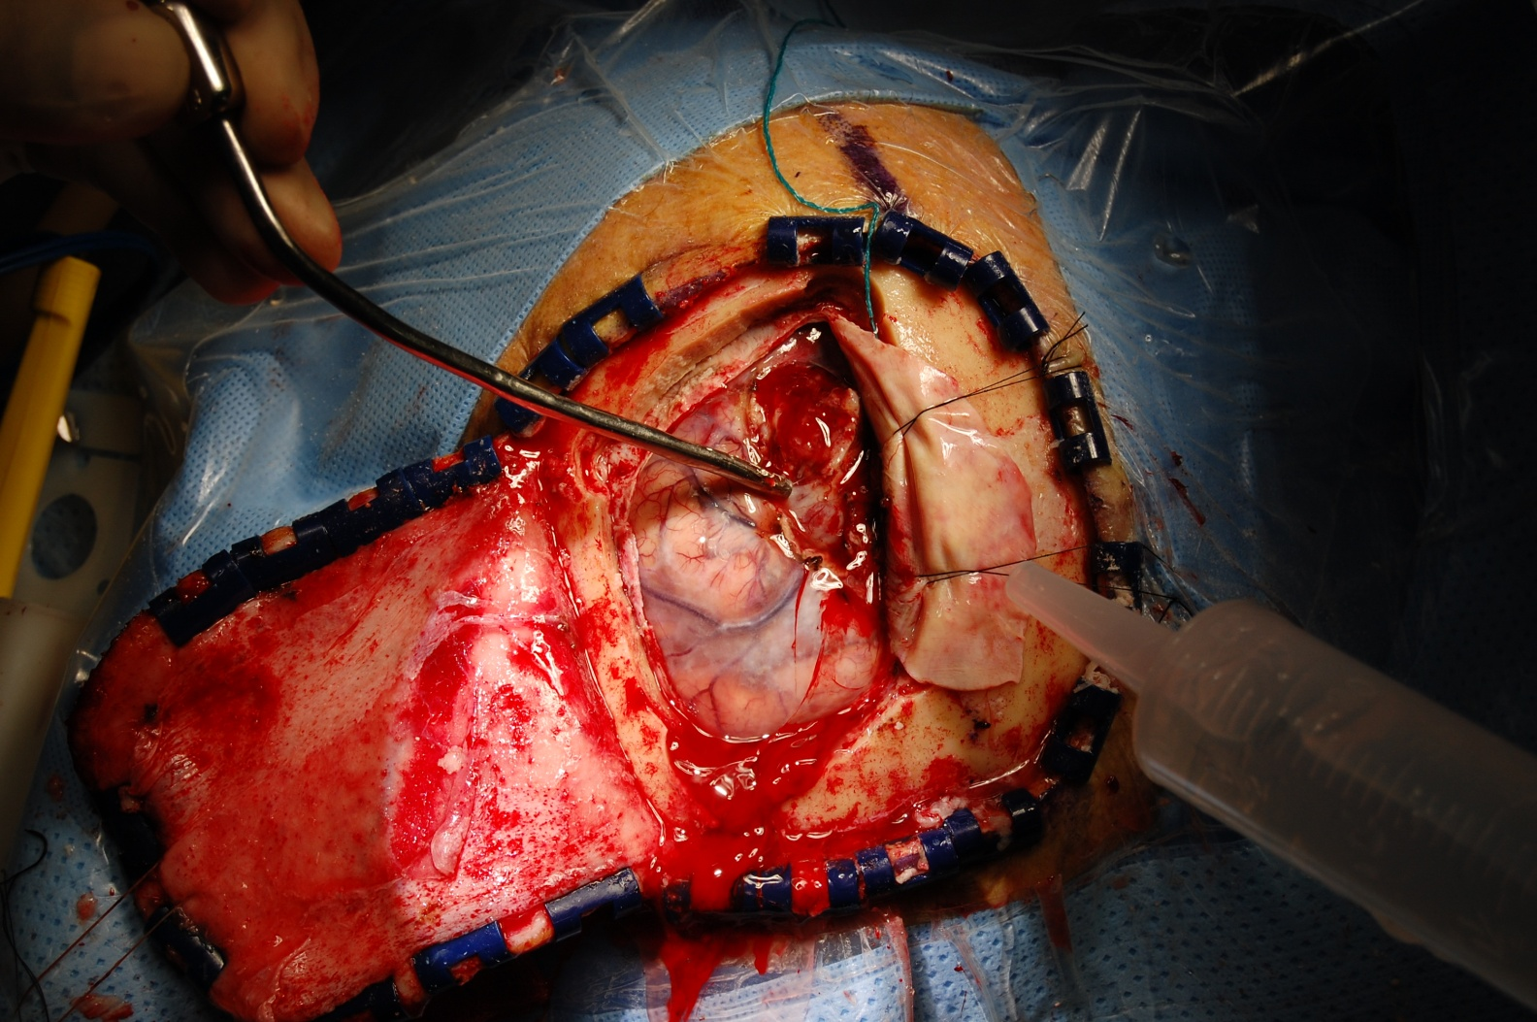
Operative Care

Slide 48
Post Op Course
Initially uneventful, extubated POD 1
Transferred to the floor POD2
Mild weakness, mild hemiparetic gait
Nurse noticed increased work of breathing on POD3
VS HR 124, RR 26, O2 Sat 88%
What is wrong?
48

Slide 49
Meningioma
Meningioma carries the highest risk of DVT of all intracranial tumors (22-45%)
Survival better in young people (81% in patients aged 21 to 64 and 56% for patients 65 years of age or older.)
5 year recurrence after any treatment 18.2-27.2%
Location an important variable in morbidity- proximity to venous sinuses, brain stem, sella, optic nerve
Sources: Central Brain Tumor Registry of the United States, Sawaya R, Cummins CJ, Kornblith PL: Brain tumors and plasmin inhibitors. Neurosurgery 15:795800, 1984, Sawaya RE, Ligon BL: Thromboembolic complications associated with brain tumors. J Neurooncol 22:173181, 1994, Sawaya R, Zuccarello M, Elkalliny M, et al: Postoperative venous thromboembolism and brain tumors: Part I. Clinical profile. J Neurooncol 14:119125, 1992

Slide 50
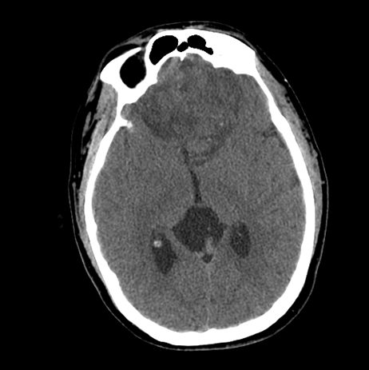
Case 2
24 yr old Golf instructor who presented after auto v tree, seizure on scene.
Large sub-frontal meningioma noted on imaging. Underwent surgical resection
Uneventful hospital stay
Discharged home, called back to clinic 8 days later complaining of “runny nose” described as clear.
The office nurse recommended “Sudafed and an allergy medicine, call back if you run a fever.”

Slide 51
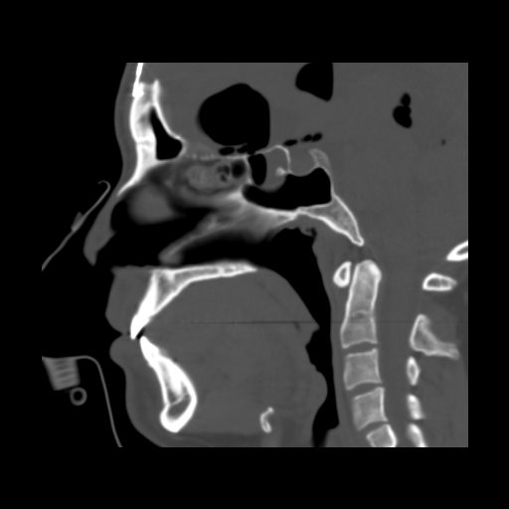
Imaging Follow Up
Pneumocranium with CSF communication through sphenoid sinus
Immediately admitted
Underwent:
Endoscopic repair of sphenoid and Septoplasty,

Slide 52
Summary
Benign is really a misnomer, even the “good ones” can behave badly
The brain is like real estate- location matters
All patients with benign brain tumors need follow up- even those resected can recur
Depression is one of the most common post operative complications (37% in HGG)- encourage treatment!

Slide 53
Summary
Be vigilant about prevention of complications
Meningioma has the highest rate of DVT of all brain tumors
Read the consent… you can learn a lot about what complications to look for
Prevent exposure keratopathy in facial weakness
Advocate for psychological support and out patient services to ensure that patients recover

Slide 54
Future of Neuro-Oncology
Chemosensitivity Testing
DNA / Tumor Markers with customized chemotherapy regimens
Monoclonal antibodies
Gene therapy
Immunotherapy
Vaccines
Notes:
Future of Neuro- Oncology
Chemosensitivity Testing
95% accuracy able to detect resistance in the laboratory
50% or more accuracy able to detect sensitivity in the patient
DNA / Tumor Markers
detect aggressive of tumors – Ki67,
P53 – tumor suppressor gene
detect resistance to BCNU (GBM) - over-expression – MGMT
Monoclonal antibodies
Gene therapy
Manipulation of genetic machinery of the cell
Random gene insertion of normal copy of gene into target tissue
Clinical gene transfer…insertion of marker gene for assistance in correction of enzyme deficiency
Immunotherapy
Vaccine
Blocks effect for tumor cells to grow

