Slide 1
World federation of neuroscience nurses
Managing External Drainage of CSF:
Practical tips for nursing care

Slide 2
Objectives
To provide an overview of basic principles of CSF diversion including the following:
Indications for CSF drainage
Types of CSF diversion systems
Nursing care and management of EVD’s and lumbar drains

Slide 3
Why do we drain CSF?
To treat high pressure states in selected patient
Control elevated intracranial pressure by draining CSF
Normal Pressure Hydrocephalus
Obstructive hydrocephalus
Communicating hydrocephalus
To treat or prevent leaking of CSF when the dura has been surgically opened
Shunt infections (externalize drainage while treating infection)

Slide 4
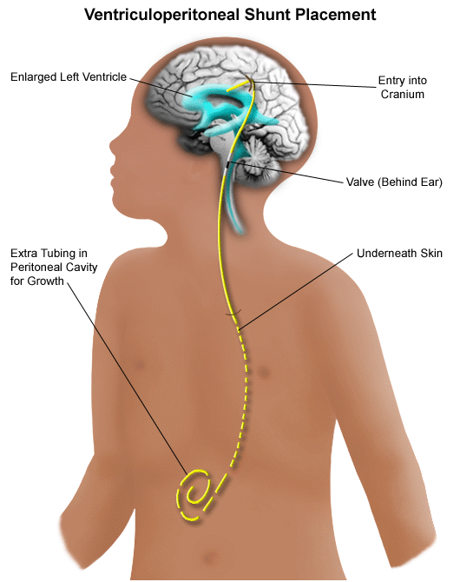
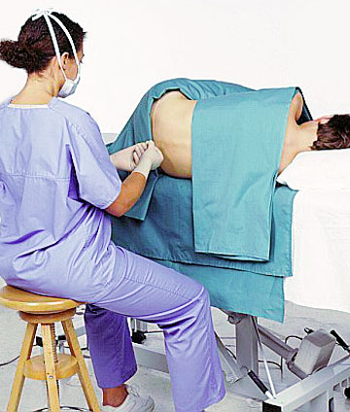
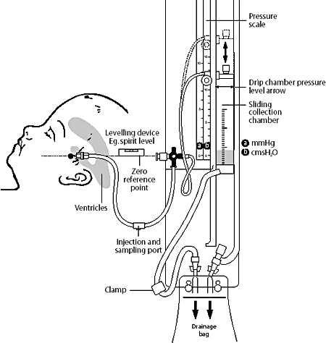
Options for CSF diversion

Slide 5
What is an external ventricular drain (EVD)?
A drain that is placed surgically into the ventricles
Generally tunneled and sutured to the scalp
Always document the opening pressure if performed at bedside
Allows CSF to drain into a sterile bag
Can be helpful in treating:
Elevated intracranial pressure
Diverting CSF to treat an infection
Clearing blood products from the ventricles

Slide 6
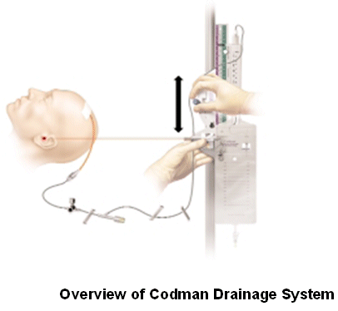
External ventricular drain nursing care
Level the drain to ordered level
Observe drainage hourly
Call a supervising provider for drainage less than or more than expected values
If transduced, treat elevated ICP by opening the drain when the pressure exceeds the prescribed level

Slide 7
External ventricular drain nursing care
Clamp if out of bed/ re-level with bed adjustment
CSF sampling is no longer considered standard of care
Dressings have not been found to reduce the risk of infection
Observe insertion site for signs infection or CSF leakage

Slide 8
What is a lumbar drain?
A closed sterile drain system that is placed in the subarachnoid space to drain CSF
Generally placed at L3-4 (spinal cord ends at T12-L1)
Common indications include:
Diagnostic evaluation of idiopathic intracranial HTN
Diversion of CSF after dural tear or CSF leak
Diversion during treatment of a shunt infection
Thoracolumbar aortic aneurysm to improve spinal cord perfusion

Slide 9
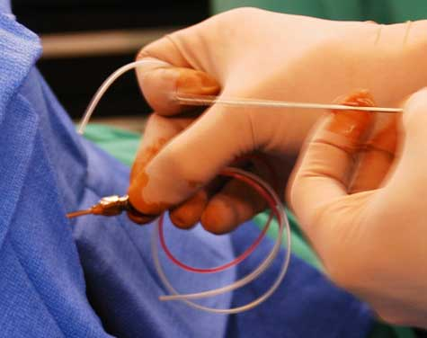
Lumbar drains nursing care
Level the drain to ordered level
Observe drainage hourly
Call if drainage exceeds or is less than expected values
Educate the patient to call for help before getting out of bed (clamp drain)
Re-level with any bed adjustment

Slide 10
Lumbar drains nursing care
Consider restraints/family sitter if unable to follow instructions
Transparent dressings should be in place and observed every shift
Avoid contamination during peri-area care
If required, dressing changes should be sterile
Observe insertion site for signs infection, leakage of CSF

Slide 11
Sampling CSF for culture (example)
ALWAYS follow your hospital procedures
Don clean gloves, mask
Prep side port below the buretrol with two betadine prep pads and allow to dry 3 minutes (ensure sampling port remains sterile)
Insert needle into side port below the buretrol port and withdraw sample at least of 1 ml of CSF
Replace needle with sterile blue cap
Label specimen with date/time collection and nurses signature
Send to lab for analysis with lab requisition

Slide 12
Nursing care of the all CSF drains
Assess insertion site every four hours for signs/symptoms of infection or signs of CSF leakage around insertion site
Assess patient every four hours for signs/symptoms of meningeal irritation
Check integrity of dressing every shift and reinforce if needed
Observe the drainage system, color and clarity of CSF drainage hourly

Slide 13
Nursing care of the drain
Maintain the integrity and sterility of the closed system by keeping all connections tight
If system becomes disconnected at catheter site, clamp catheter with a sterile clamp and notify physician or nurse practitioner
Assure tubing is not kinked
NEVER INJECT ANYTHING INTO THE SYSTEM

Slide 14
Troubleshooting the EVD or lumbar drain
No CSF drainage ( < 5ml/hr) when drain open at prescribed level
Check system integrity for loose connections (never reconnect a broken drain- turn the stop cock proximal to the break to off, cover site with sterile 4x4 and call neurosurgery)
Confirm all stopcocks open
Check drain patency by briefly lowering the drain, observe for dripping
Document troubleshooting measures
Call neurosurgery if still no drainage

Slide 15
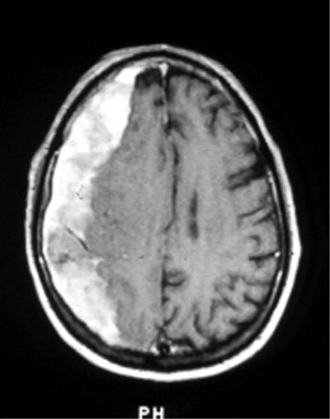
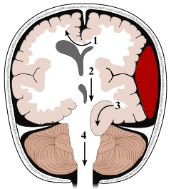
Serious complications from over-drainage

Slide 16
What NOT to do…..
Never treat a lumbar drain or EVD like a foley catheter
Too much drainage can cause intracerebral hemorrhage or herniation
Never disconnect/open the system
This can cause meningitis, pneumocephalus
Never let patients get out of bed without clamping the system
Educate patients/families about the dangers of over-drainage
re-level after all bed adjustments

Slide 17
Summary
CSF drains are an important treatment strategy for high pressure states and diverting CSF during shunt infection or after durotomy
External sites and drainage must be observed hourly
Care should be taken to maintain the drain at the prescribed level
Patients should be assessed routinely for any change in neurological assessment

